Slide 1
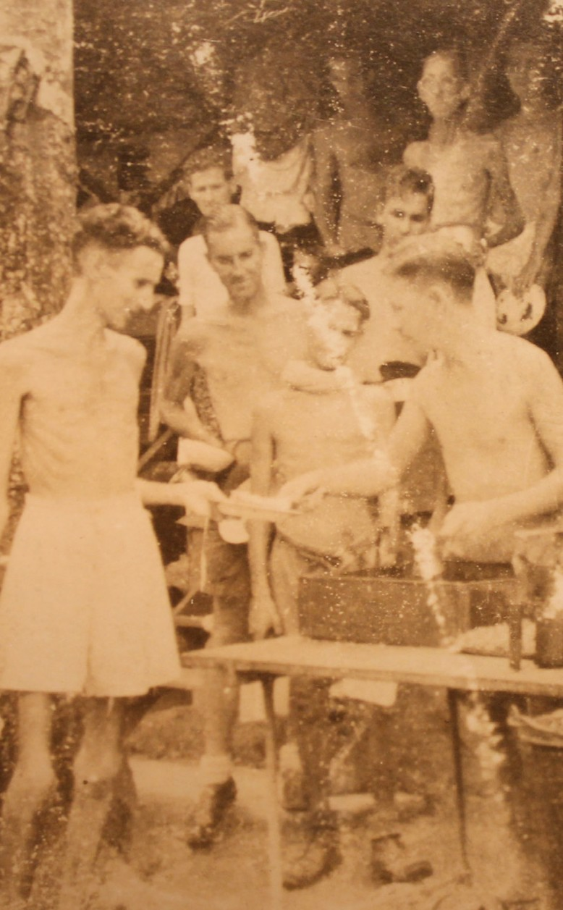
Worksheet 4
EvidencE 3: Food and raTions
December 1942
(Ounces per man per day)
Rice polished - One ounce gives 110 cal- ories but has very few vitamins. The rice was stored in hot and damp conditions for long periods of time.
Rice (polished) | 24.7
Sugar | 0.7
Salt | Nil
Oil | 0.09
Tea | 0.08
Vegetables | 16.2
Pork or Dried Fish | 1.0
Wheat flou | Nil
Sugar - One ounce gives 100 calories but is deficient in all vitamins.
Oil - One ounce gives 257 calories and vitamins A, B1 and the B2 complex are present.
Vegetables - The rations included Chinese radish, pumpkin, sweet potatoes and dried cabbage. Of these, pumpkins contain vitamin A and sweet potatoes B1.
Pork and dried fish - The amounts supplied gave negligible quantities of calories. Pork, however, contains vitamin B1 and the B2 complex.
Wheat Flour - This ceased to be a ration after the middle of 1942.
Food queue at Kranji POW Hospital camp, 1945, photograph by Bill Norways, © courtesy the Norways family

