Slide 1
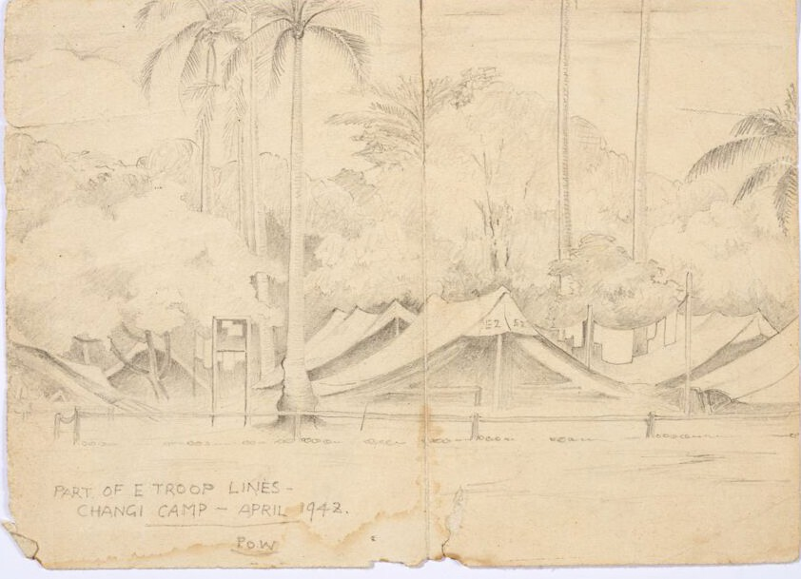
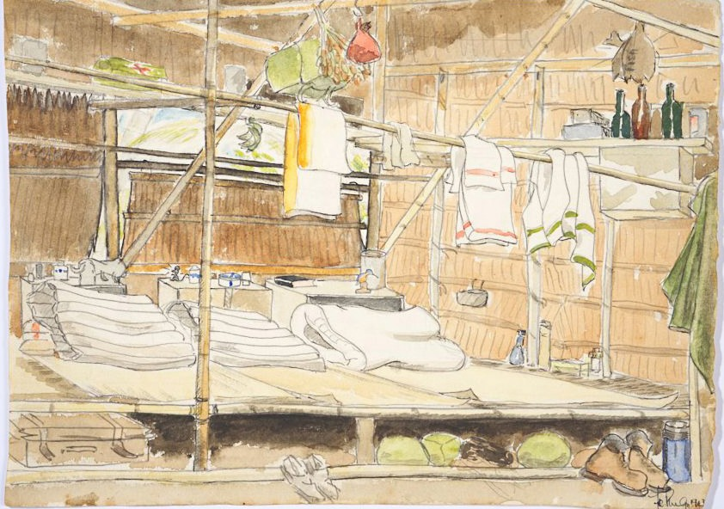
Worksheet 2 - examples of pictures
E Troop lines, tented camp, 1942, sketch by Driver Donovan Clarke, © Clark family, courtesy C. Tuffrey
Inside medical officers’ hut, 1943, by Fl/Lt F.R. Philps, © Philps family
1

Slide 2
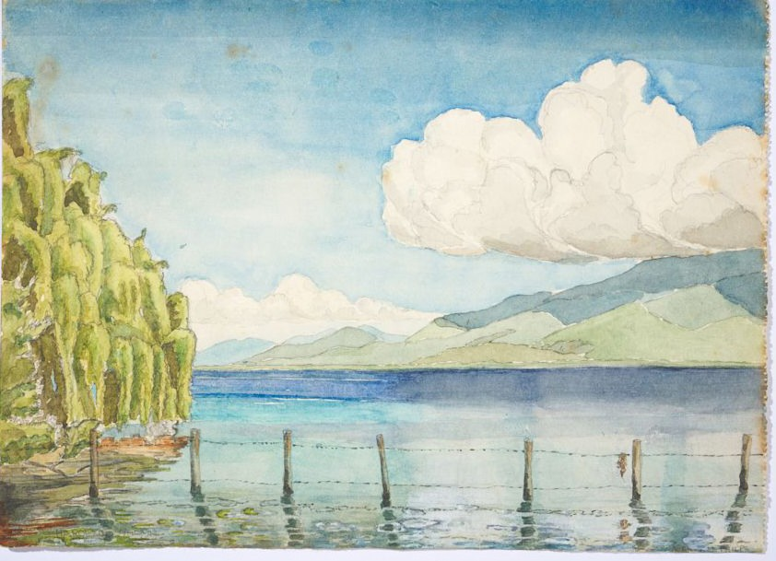
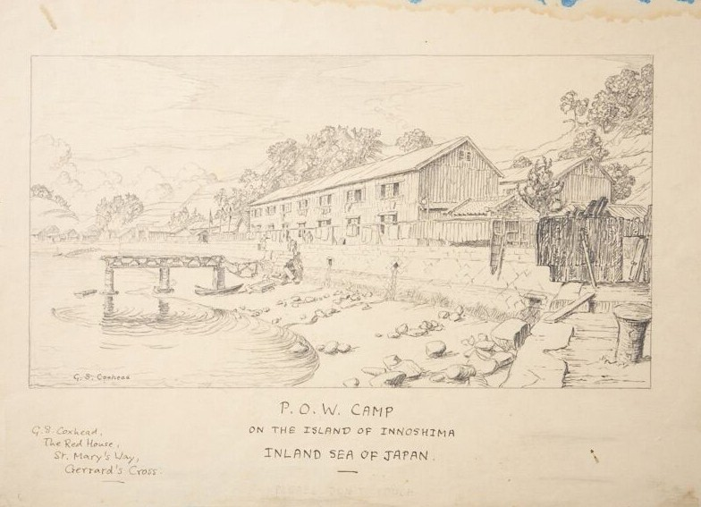
Worksheet 2 - exAmples of pictures
View from Haroekoe Island, Moluccas, 1944 by Fl/Lt F.R. Philps, © Philps family
Camp view, Japan, drawn by Gunner G.S. Coxhead, © courtesy of J. Coxhead
2

Slide 3
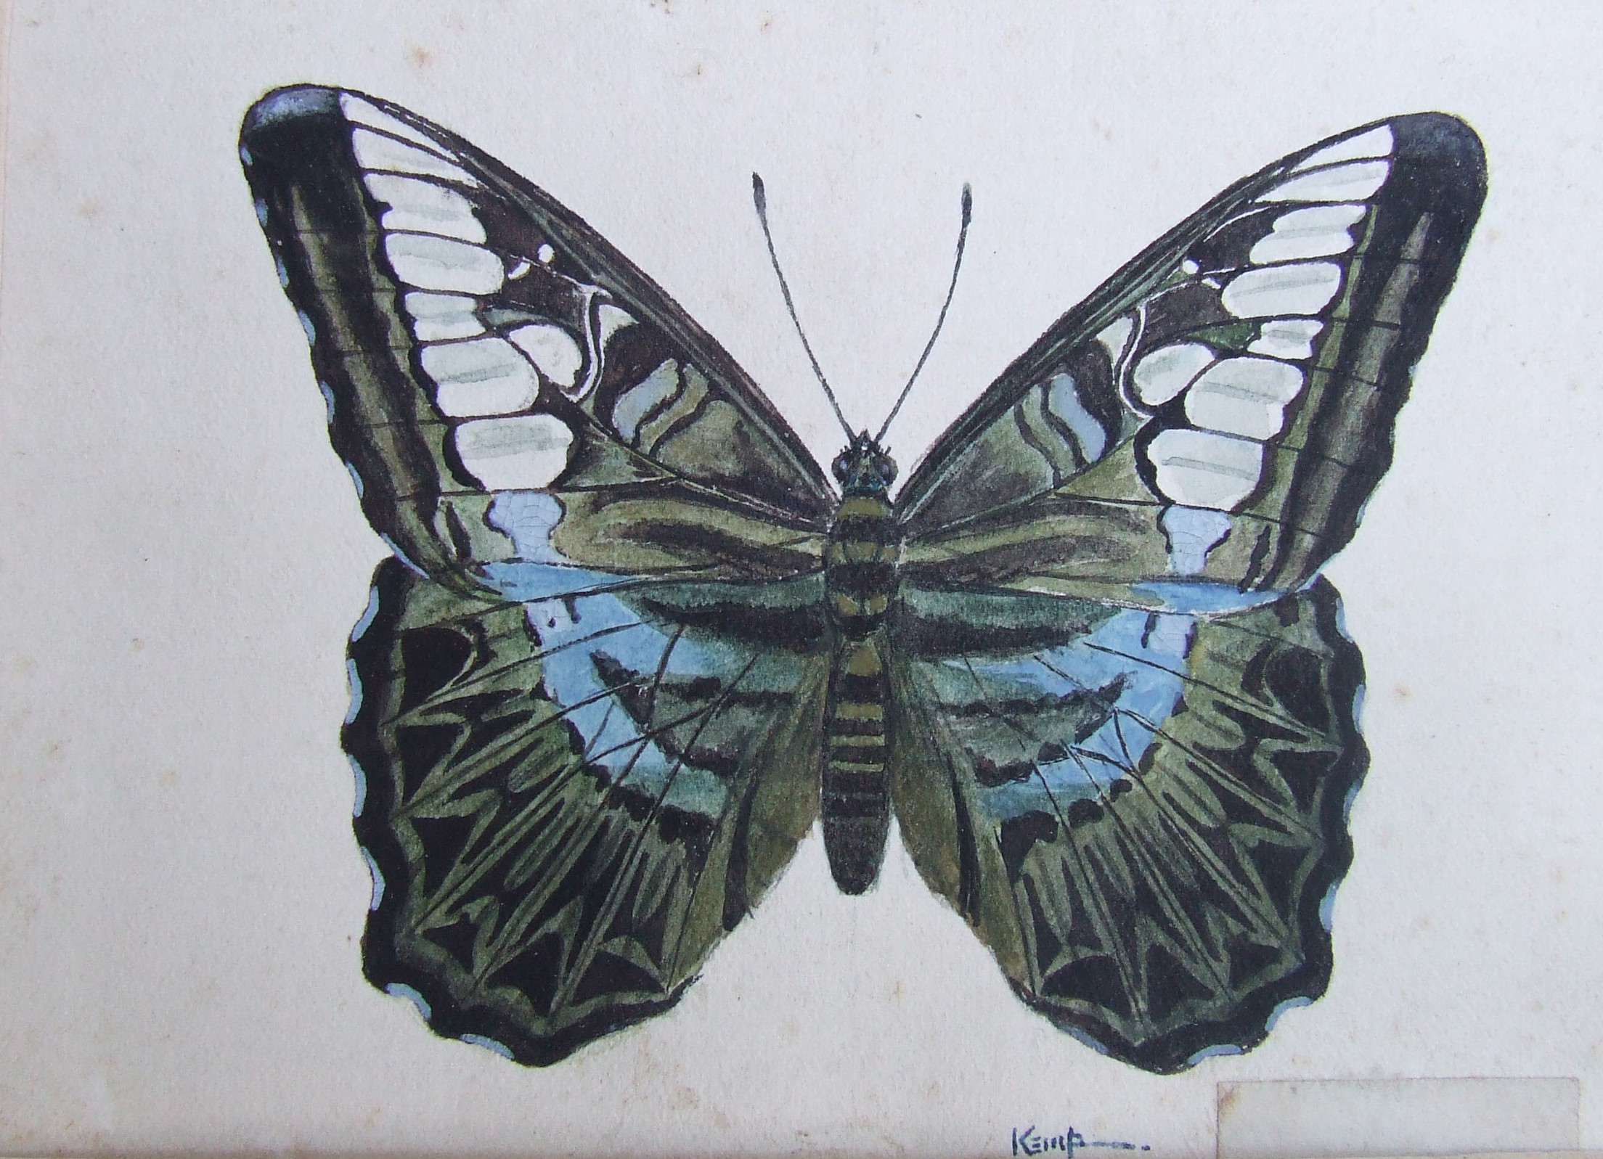
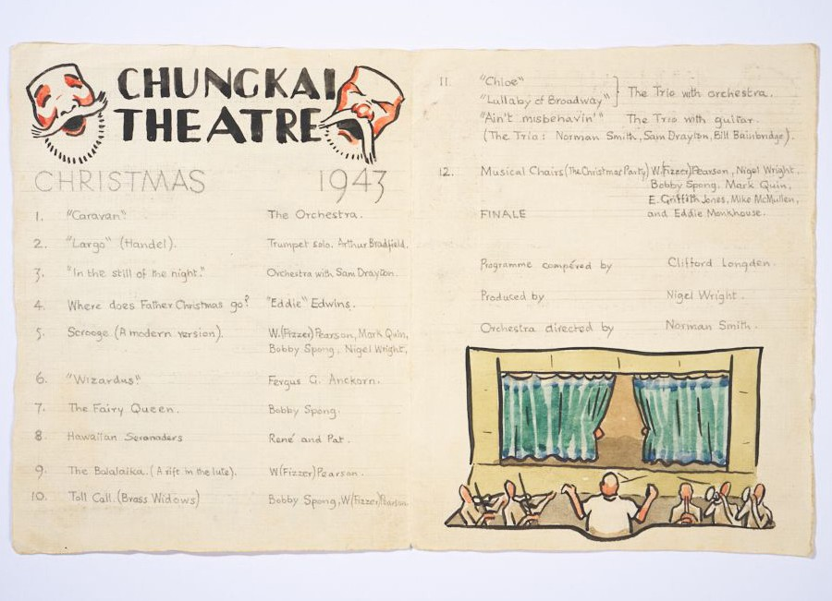
Worksheet 2 - exAmples of pictures
Tropical butterfly, Thailand 1943-44, painted by Sgt Jack Kemp, © J. Upcraft and courtesy W. Bird
Chungkai theatre programme, 1943, by L/Bdr R.G. Brazil, © courtesy N. Pearson
13

Slide 4
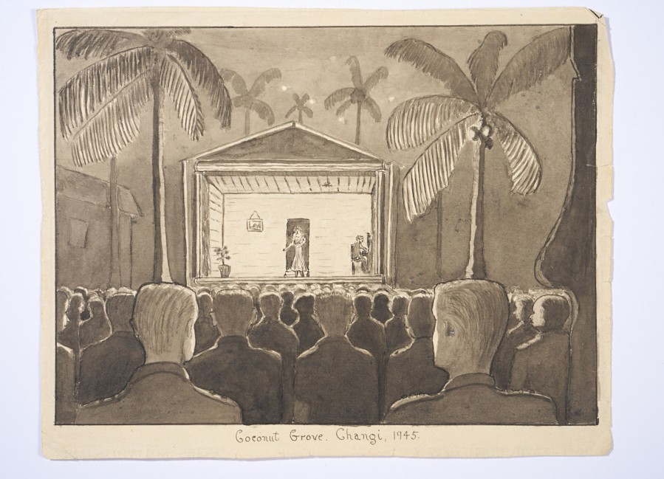
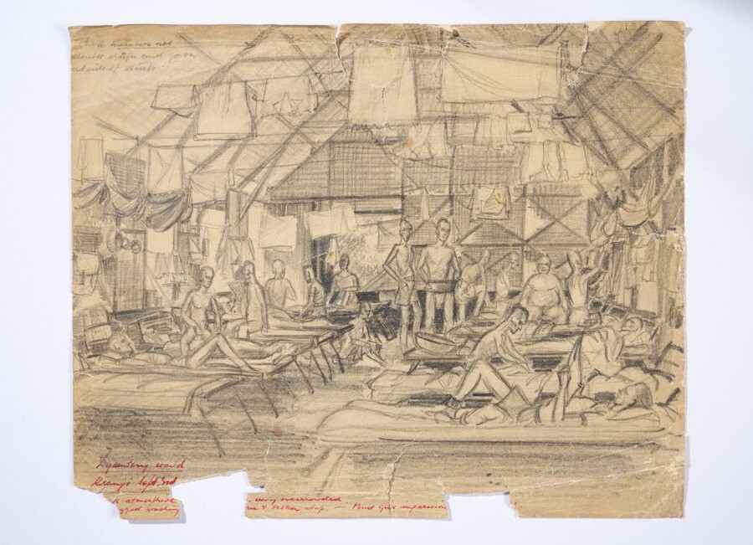
Worksheet 2 - exAmples of pictures
Coconut Grove Theatre, Changi Gaol, Singapore 1945, painted by Capt T. Wilson, © courtesy the Wilson Family
Sketch of Dysentery hut, Kranji POW camp Singapore, 1945 by W.G Norways, © courtesy of G.& T. Norways

