Slide 1
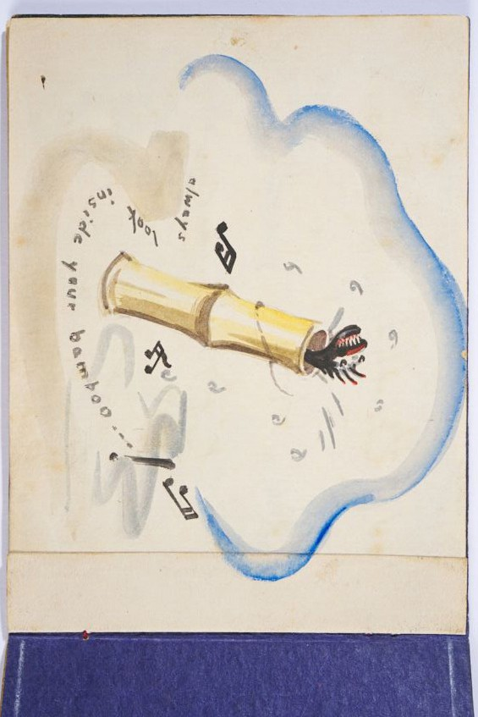
Worksheet 3 - bAmboo picture
Greetings card, back page, 1944 by Jack Chalker, © and courtesy N. Pearson

