Slide 1
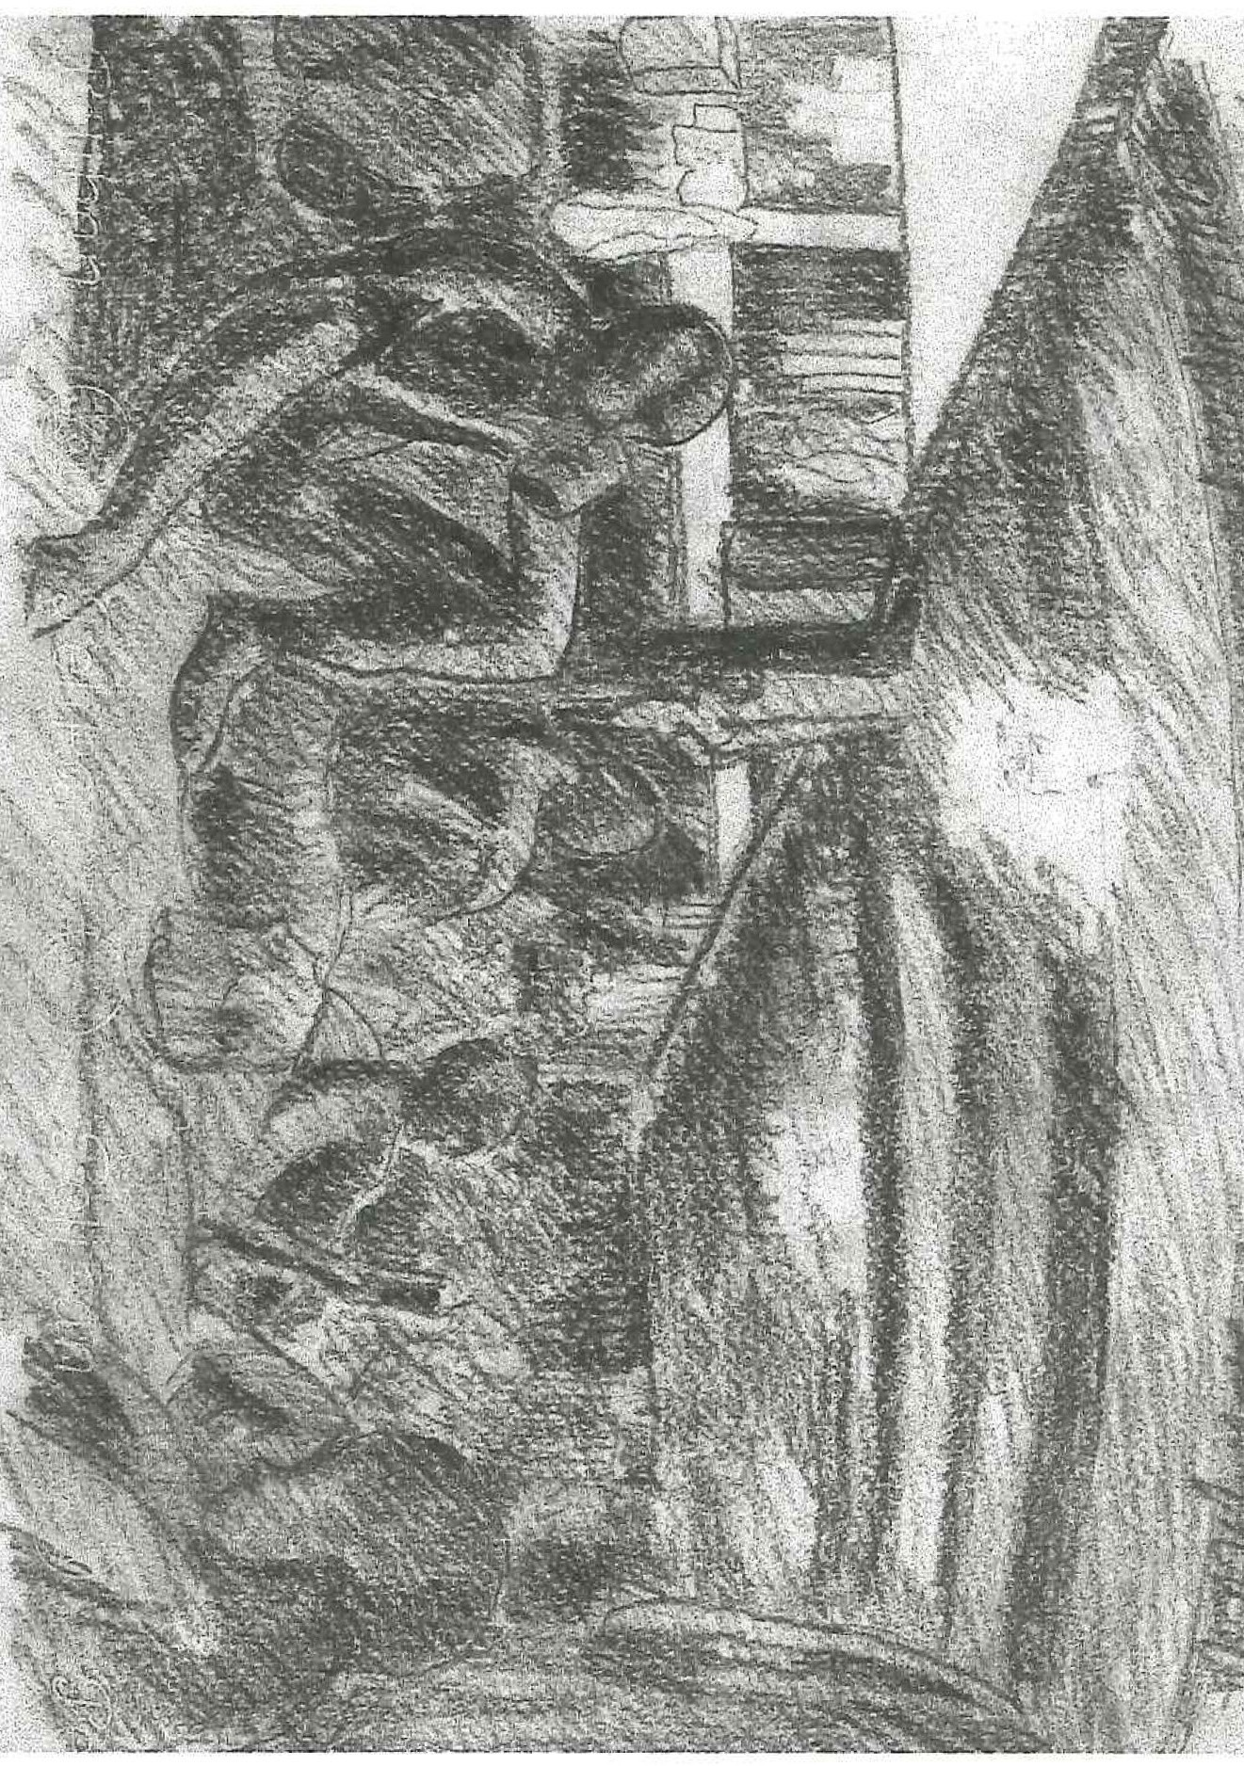
Worksheet 4
EvidEncE 1: TravEl by ship
The men were confined to the holds of small ships for the whole of long and arduous journeys.
Sketch of below decks on board England Maru, Singapore to Taiwan late 1942, drawn by Padre F. Stallard,
© courtesy Stallard family

