Slide 1
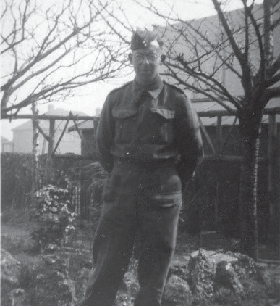
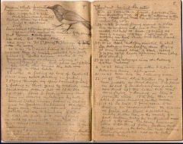
Worksheet 6
Role play: ronald john “jack” spittle
PRIVATE RONALD JOHN “JACK” SPITTLE
Name: Jack Spittle, Royal Army Medical Corps
Age: 27 when captured
From: Slough, Buckinghamshire
Key skills and strengths:
Trained in public health and sanitation (keeping things clean)
Went to the Army School of Hygiene and was a trained orderly in the anti- malarial squad in the Royal Army Medical Corps
He worked at Roberts Hospital in Changi POW camp where he was a prisoner of war
A keen amateur entomologist (studied insects) and ornithologist (studied birds)
Knew how to create anti-fly spray and handwash
He wrote copious notes on whatever paper he could find including
backs of envelopes and cardboard packages
Jack Spittle, photograph courtesy B. Spittle
Jack Spittle’s bird observation notebook during captivity in Singapore, © courtesy B. Spittle
© LSTM FEPOW oral history interview with Jack Spittle

Slide 2
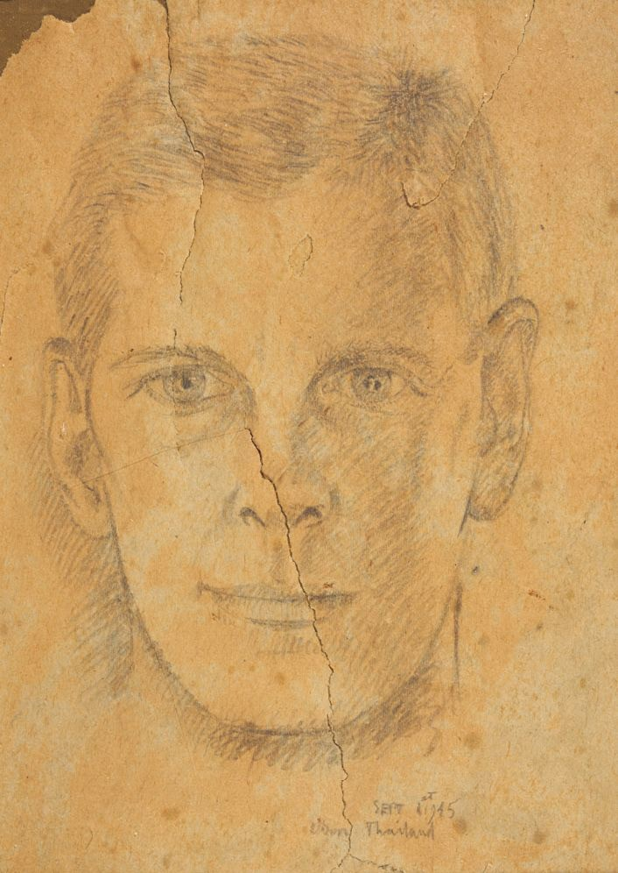
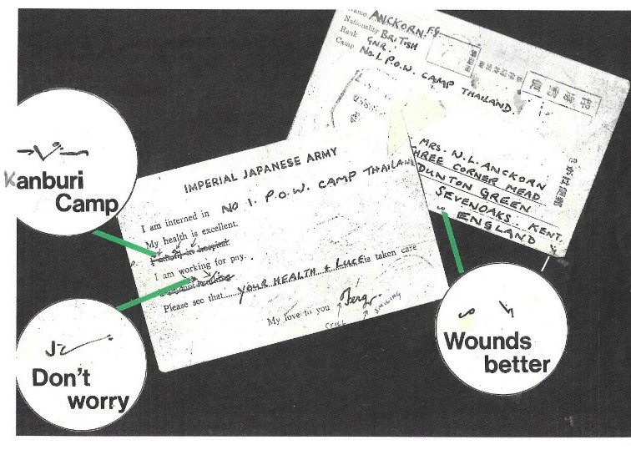
Worksheet 6
Role play: Fergus Gordon Anckorn
FERGUS GORDON ANCKORN
Name: Fergus Anckorn, Gunner, 135 Field Regiment, Royal Artillery
Age: 23 when captured
From: Sevenoaks Kent
Key skills and strengths:
He worked on the earth party helping build the Thai-Burma railway working 18 hours a day
Sent a coded message on a postcard from a camp in Thailand, using Pitman’s shorthand to cross out unwanted statements, to his journalist parents back in England so they knew he was alive
He was taught how to do massage for people who had muscle wasting and vitamin deficiency
Found a way to keep the mosquitoes away by turning a blanket into a sleeping bag, getting inside and buttoning it up tight at night time. He said this was his way of avoiding malaria which killed many people
Loved languages and learnt Dutch
He said it saved his life being able to do magic as the Japanese loved his
magic in the camps. He did tricks which involved touching food as Japanese guards thought all prisoners of war were ‘verminous’ and would not eat anything they had touched
Distracted Japanese guards with magic whilst on working parties on the railway so that they could get longer breaks
© LSTM FEPOW oral history interview with Fergus
Portrait of Fergus Anckorn, 1945, by William Wilder,
© Anthony Wilder
Explaining the shorthand crossings out, by Fergus Anckorn, © courtesy F. Anckorn
Can you spot Fergus on the Chungkai theatre programme on page 13?
Anckorn 2007.
26

Slide 3
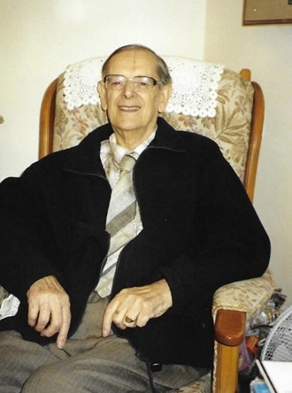
Worksheet 6
Role Play: Derek Fogarty
DEREK FOGARTY
Name: Derek Fogarty, Royal Air Force
Age: 19 when captured
From: Fareham, Hampshire
Key skills and strengths:
Moved scrap iron and bombs and had to carry hundreds of pounds of manganese ore in sacks
Made rope
Became a fully qualified pig breeder
Helped build a camp using wood and bamboo and dug latrines in just three days
Helped dig wells and create a football pitch
Photograph of Derek Fogarty at home December 2007, courtesy M. Parkes
Believed that the bonds between prisoners was what helped keep people alive. The Dutch word that is often used is kongsi, meaning a clique, a ring, to describe this close group of friends
© LSTM FEPOW oral history interview with Derek Fogarty, 2007
Derek, on bonding with other prisoners:
“If you have marched 30 or 40 miles with somebody and you have been through combat with people you have something which is a bond. You’ve been a prisoner for months, you have been through troubles together, you’ve shared your water bottle together. A lot of you were frightened and you we were all scared in a lot of ways and you talked to people and you bonded like two brothers. You looked after them when they were sick, if a person was sick took them water and you did their washing, and you can never describe the bonding we were so close and it got closer and closer over the years. People would die for their mates that is how close things got.”
3

Slide 4
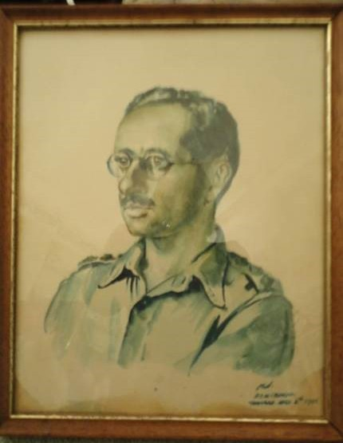
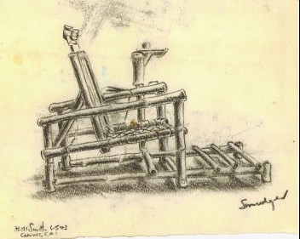
Worksheet 6
Role play: David Arkush
DAVID ARKUSH
Name: Captain David Arkush, Dental Officer in Army Dental Corps
Age: 27 when captured
From: London
Key skills and strengths:
Worked as a dentist in Roberts Hospital, Changi POW camp, Singapore
In Thailand he had a dental chair made for him
He took plaster impressions to make dentures
He was allowed to leave the camp to find pain killers and could buy things from the local shop
Portrait of Capt Arkush by A. G. Old, Thailand 1943,
© courtesy the Arkush family
He was allowed to take patients to the POW dental officer in the nearby camp as he had better equipment
He could trade things in the local town and bought things such as earphones to hear the radio (a secret radio in the camps)
© LSTM FEPOW oral history interview with David Arkush, 2007
Bamboo dental chair made at Chungkai Hospital camp Thailand, sketched by Lieutenant F. Ransome-Smith,
© courtesy C. Ransome and Museum of Military Medicine
4

Slide 5
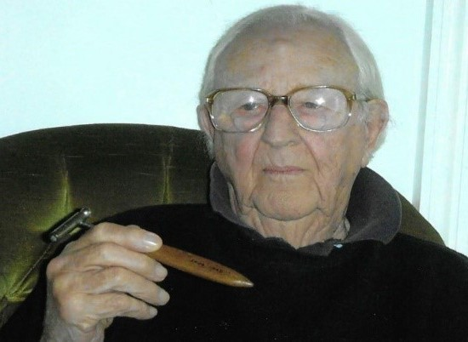
Worksheet 6
Role Play: Nowell Peach
NOWELL PEACH
Name: Nowell Peach
RAF Medical Service
Age: 28 when captured
From:
Bristol
Former Fl/Lt Nowell Peach holding the home-made patella hammer he had made in 1943 in Tandjong Priok POW camp, Java, photograph courtesy M. Parkes
Key skills and strengths:
Carried out emergency surgery
Spent hours going through the Gray’s Anatomy medical text book and made lots of notes that helped him pass medical exams on his release
To avoid malaria he made sure he wore long sleeved tops and long trousers and stayed in his mosquito net at night time
Looked after people with dysentery and those suffering from vitamin deficiency disorders
Worked in St Vincentius hospital staying on the wards to look after the men
He designed a special leg support to help a man with foot drop to walk again - by tying a band below the knee and another one around the foot with string to hold the foot up
Played chess and badminton in the camps
Drew many pictures of birds in a diary he kept
“I also had a stainless steel handle made, to carry razor blades, used as a scalpel.”
“I got again the engineers to convert a normal iron bedstead into an orthopedic bed
...They made wheels to go up and down on the side rails of the bed and then a sort of pulley at the end so you could pull the sliding part down, and so you could put the patient on this to extend his hip joint.”
© LSTM FEPOW oral history interview with Nowell Peach, 2007 and 2008
5

