Slide 1
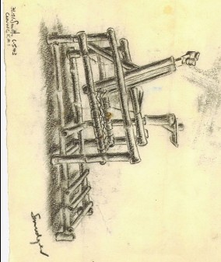
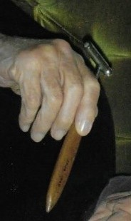
Worksheet 7
inventor challenge
A patella hammer for testing reflexes, photograph courtesy M. Parkes
Bamboo dental chair made at Chungkai Hospital camp Thailand, sketched by Lieutenant F. Ransome-Smith,
© courtesy C. Ransome and Museum of Military Medicine
1

