Slide 1
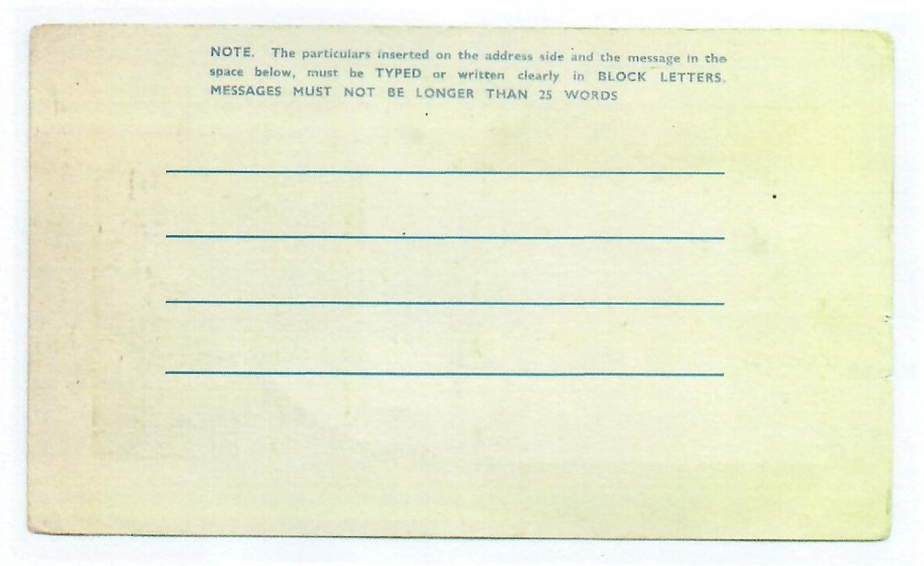
Worksheet 8
postcard home
Postcard 1: Write a postcard home hiding the truth about life in the camps. (You would not be allowed to tell them the truth)
Postcard 2: Write a postcard home imaging you could tell the truth about life in the camps. You only have 25 words
1

